Slide 1
14 PRESIDENTS
OF THE
PHILIPPINES

Slide 2
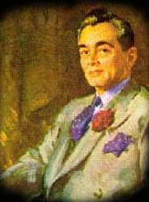

Slide 3
A. SERGIO OSMENA
B. DIOSDADO MACAPAGAL
C. MANUEL QUEZON

Slide 4
2nd President of the Philippines 1st President of the Commonwealth
In office November 15, 1935 – August 1, 1944
Born | August 19, 1878) Baler, Aurora
Died | August 1, 1944 (aged 65) Saranac Lake, New York, United States
Political party | Coalición Nacionalista
Spouse | Aurora Aragon
Occupation | Lawyer
Religion | Roman Catholic
Signature
MANUEL L. QUEZON

Slide 5
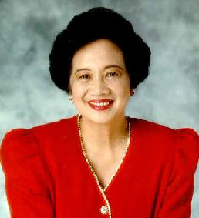

Slide 6
A. CORAZON AQUINO
B. LOREN LEGARDA
C. MIRIAM SANTIAGO

Slide 7
Born: 25-Jan-1933 Birthplace: Manila, Philippines
Gender: Female Race or Ethnicity: Other Sexual orientation: Straight Occupation: Head of State
Nationality: Philippines Executive summary: Former housewife turned political widow
Father: José Cojuangco, Sr. Husband: Benigno Aquino (Philippine Senator, m. 1955, five children, d. 1983 assassination) President of the Philippines 25-Feb-1986 to 30-Jun-1992 Time Man of the Year 1986
CORAZON AQUINO

Slide 8
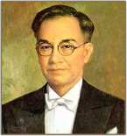

Slide 9
A. FERDINAND MARCOS
B. JOSE LAUREL
C. JOSEPH ESTRADA

Slide 10
JOSE P. LAUREL
3rd President of the Philippines President of the 2nd Republic
In office October 14, 1943 – August 17, 1945
In office February 29, 1936 – February 5, 1942
Born | March 9, 1891) Tanauan, Batangas
Died | November 6, 1959 (aged 68) Manila
Political party | Kapisanan ng Paglilingkod sa Bagong Pilipinas (KALIBAPI)
Spouse | Pacencia Hidalgo
Occupation | Lawyer
Religion | Roman Catholic
Signature

Slide 11
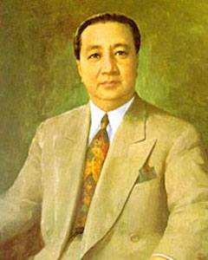

Slide 12
A. ELPIDIO QUIRINO
B. JOSE LAUREL
C. NOLI DE CASTRO

Slide 13
ELPIDIO QUIRINO
Born: 16-Nov-1890 Birthplace: Vigan, Ilocos Sur, Philippines Died: 29-Feb-1956 Location of death: Manila, Philippines Cause of death: Heart Failure
Gender: Male Religion: Roman Catholic Race or Ethnicity: Multiracial Sexual orientation: Straight Occupation: Head of State
Nationality: Philippines Executive summary: 6th President of the Philippines
Ilocano (paternal) and Spanish (maternal) descent.
Father: Mariano Quirino Mother: Gregoria Rivera President of the Philippines 18-Apr-1948 to 30-Dec-1953

Slide 14
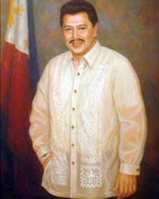

Slide 15
A. PIOLO PASCUAL
B. JOSEPH ESTRADA
C. CARLOS GARCIA

Slide 16
13th President of the Philippines 3rd President of the 5th Republic
In office June 30, 1992 – June 30, 1998
Born | April 19, 1937 ) (age 70) Tondo, Manila
Political party | Partido ng Masang Pilipino (PMP)
Spouse | Luisa Pimentel
Occupation | Actor
Religion | Roman Catholic
JOSEPH EJERCITO ESTRADA

Slide 17
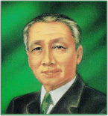

Slide 18
A. MANUEL ROXAS
B. SERGIO OSMENA
C. EMILIO AGUINALDO

Slide 19
4th President of the Philippines 2nd President of the Commonwealth
In office August 1, 1944 – May 28, 1946
In office November 15, 1935 – August 1, 1944
Born | September 9, 1878 Cebu City, Cebu
Died | October 19, 1961 (aged 83) Quezon City
Political party | Nacionalista Party
Spouse | Esperanza Limjap
Occupation | Lawyer
Religion | Roman Catholic
SERGIO OSMENA

Slide 20
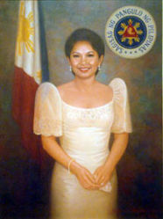

Slide 21
A. GLORIA MACAPAGAL ARROYO
B. KRIS AQUINO
C. MARIAN RIVERA

Slide 22
President of the Philippines
Incumbent
Assumed office January 20, 2001
Vice President | Noli de Castro
Born | 5 April 1947 ) (age 60) San Juan, Rizal
Political party | LDP (1992-1998) Lakas-CMD (1998-) KAMPI (1997-)
Spouse | Jose Miguel Arroyo
Occupation | Economist
Religion | Roman Catholic
GLORIA MACAPAGAL ARROYO

Slide 23
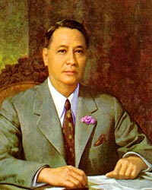

Slide 24
A. FIDEL RAMOS
B. MANUEL ROXAS
C. JOSEPH ESTRADA

Slide 25
5th President of the Philippines 3rd President of the Commonwealth 1st President of the 3rd Republic
In office May 28, 1946 (as Commonwealth President until July 4, 1946, as Republic President thereafter) – April 15, 1948
Born | January 1, 1892) Capiz (now Roxas City), Capiz
Died | April 15, 1948 (aged 56) Clark Air Base, Angeles, Pampanga
Spouse | Trinidad de Leon
Occupation | Lawyer
Religion | Roman Catholic
MANUEL ROXAS

Slide 26
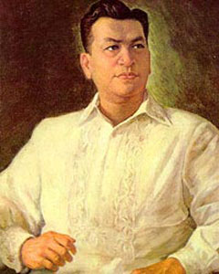

Slide 27
A. RAMON MAGSAYSAY
B. EMILIO AGUINALDO
C. JOSE RIZAL

Slide 28
RAMON MAGSAYSAY
Born: 31-Aug-1907 Birthplace: Iba, Zambales, Philippines Died: 17-Mar-1957 Location of death: Mt. Manunggal, Cebu, Philippines Cause of death: Accident - Airplane
Gender: Male Race or Ethnicity: Asian Sexual orientation: Straight Occupation: Head of State
Nationality: Philippines Executive summary: 7th President of the Philippines
Military service: Philippine Army (31st Infantry); Western Luzon Guerilla Forces
Father: Exequiel Magsaysay (blacksmith) Mother: Perfecta del Fierro (schoolteacher) President of the Philippines 30-Dec-1953 to 17-Mar-1957

Slide 29
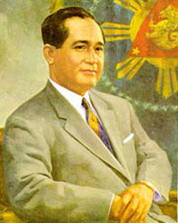

Slide 30
A. APOLINARIO MABINI
B. DIOSDADO MACAPAGAL
C. CARLOS GARCIA

Slide 31
CARLOS P. GARCIA
AKA Carlos Polestico Garcia
Born: 4-Nov-1896 Birthplace: Talibon, Bohol, Philippines Died: 14-Jun-1971 Location of death: Quezon City, Philippines Cause of death: Heart Failure
Gender: Male Race or Ethnicity: Hispanic Occupation: Head of State
Nationality: Philippines Executive summary: 8th President of the Philippines
Father: Policronio Garcia (mayor) Mother: Ambrosia Polistico
President of the Philippines (23-Mar-1957 to 30-Dec-1961)

Slide 32
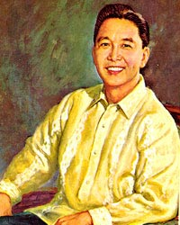

Slide 33
A. ANDRES BONIFACIO
B. FERDINAND MARCOS
C. GRACIANO LOPEZ JAENA

Slide 34
FERDINAND MARCOS
10th President of the Philippines 6th President of the 3rd Republic 1st President of the 4th Republic
In office June 12, 1978 – June 30, 1981
Born | September 11, 1917) Sarrat, Ilocos Norte, Philippines
Spouse | Imelda Romualdez

Slide 35
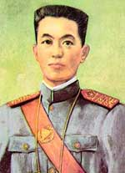

Slide 36
A. EMILIO AGUINALDO
B. MANUEL QUEZON
C. RAMON MAGSAYSAY

Slide 37
1st President of the Philippines President of the Tejeros Convention President of the Biyak-na-Bato Republic Dictator of the Dictatorial Government President of the Revolutionary Government President of the 1st Philippine Republic
In office March 22, 1897 – April 1, 1901
Born | March 22, 1869) Cavite El Viejo (Kawit), Cavite
Died | February 6, 1964 (aged 94) Quezon City, Metro Manila
Political party | Magdalo faction of the Katipunan, National Socialist Party
Spouse | Hilaria del Rosario-died Maria Agoncillo
Occupation | Military
Religion | Roman Catholic
EMILIO AGUINALDO

Slide 38
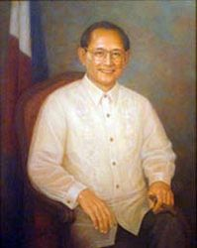

Slide 39
A. EMILIO AGUINALDO
B. MARCELO DEL PILAR
C. FIDEL RAMOS

Slide 40
12th President of the Philippines 2nd President of the 5th Republic
In office June 30, 1992 – June 30, 1998
Born | March 18, 1928 ) (age 79) Lingayen, Pangasinan, Philippines
Political party | Lakas-Christian Muslim Democrats
Spouse | Amelita Martinez
Occupation | Military
Religion | United Methodist
Signature
FIDEL V. RAMOS

Slide 41
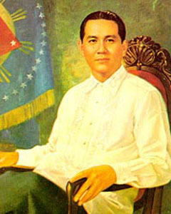

Slide 42
A. FERDINAND MARCOS
B. MANUEL QUEZON
C. DIOSDADO MACAPAGAL

Slide 43
DIOSDADO MACAPAGAL
Born: 28-Sep-1910 Birthplace: Lubao, Pampanga, Philippines Died: 21-Apr-1997 Location of death: Makati Medical Center Cause of death: Heart Failure Remains: Buried, Libingan ng mga Bayani, Taguig, Manila, Philippines
Gender: Male Religion: Roman Catholic Race or Ethnicity: Asian Sexual orientation: Straight Occupation: Head of State
Nationality: Philippines Executive summary: 9th President of the Philippines
Father: Urbano Macapagal Mother: Romana Pangan Daughter: Gloria Macapagal-Arroyo (President of the Philippines)
President of the Philippines 30-Dec-1961 to 30-Dec-1965

Slide 44
This powerpoint was kindly donated to www.worldofteaching.com
http://www.worldofteaching.com is home to over a thousand powerpoints submitted by teachers. This is a completely free site and requires no registration. Please visit and I hope it will help in your teaching.

